Slide 1

Creative Potential & A Raspberry Pi
Jen Weber, Web Developer – March 30th, 2016
Notes:
Introduce self
Tell a story - met with a CTO, who said what he looks for are people who have the ambition to make things. Rather than hire programmers, he had built his team from people who had demonstrated that spark, not just on the job, but in their lives.
That team built a web app so compelling that it eclipsed the popularity of the company’s actual product, a loan offering.
Everyone here, we ALL have that spark, and now we have the tools to do the building. We just need to imagine what to do with these new skills, and find in ourselves the ambition to bring them to life.
I really love what’s often referred to the maker movement, so when I was lucky enough to get a Raspberry Pi 3 for my birthday, I was super excited.
But I had no idea what to do with it.
As a matter of fact, the possibilities were endless and this was overwhelming. So I asked myself, what would Adam Savage do?
Well, Adam Savage would clearly do something more awesome than I would. But you know what he wouldn’t do? He wouldn’t do nothing.
So today I’m going to share with you the basics of how to get started with a raspberry pi, and some of the great things that we could make.

Slide 2
In the beginning, I didn’t know anything. It was just blind copy and paste. But after a while, I got the sense for how things worked.
-Aristotle
Notes:
About my raspberry pi and my husband who set It up

Slide 3
Outline
What is a Raspberry Pi?
What can you do with it?
Beginner projects
What now?
Resources
Notes:
Ask: What kind of projects do you have lying around? (miniatures, blank canvasses, half-refinished hardwood tray, ideas for a small business, etc). I want to be one of those people who makes cool things, but I often fall short. So we’re going to talk about what a Raspberry Pi is, but also about what it takes to be inspired and really work on something to completion.

Slide 4
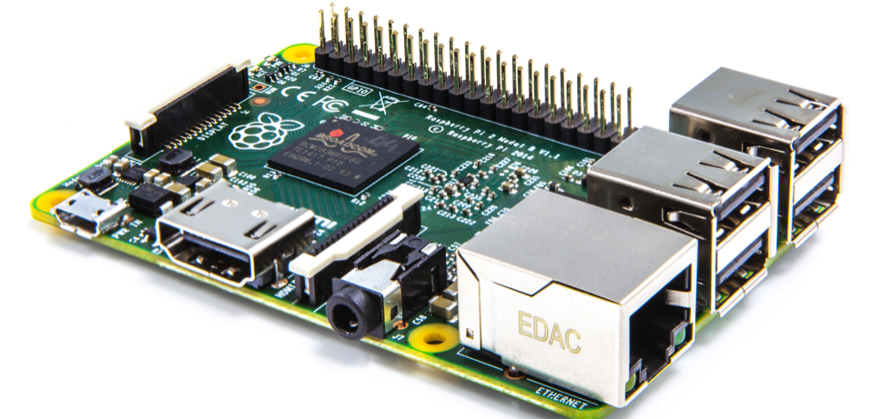
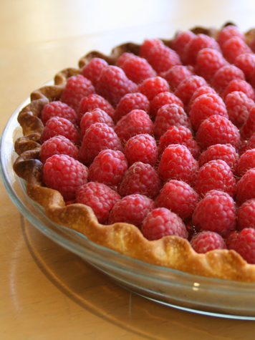
What is a Raspberry Pi?
Notes:
A raspberry pi is a credit-card sized computer.
The Raspberry Pi 3 debuted in February, and features wifi and bluetooth, with ports for an SD card, usb, camera, mic, audio, and hdmi
The latest model retails for about $40 for one, and significantly lower cost if you purchase them in bulk.
The Raspberry Zero, a slimmed down version of the first model, runs about $5 if you can get your hands on one. Most retailers have been out of stock
So, we carry computers with us everywhere now. Cell phones, laptops, game consoles, even fridges can have a computer in them.
What’s the value of a Raspberry Pi? Aside from building your own stuff, which is unbelievably cool, this allows for experimentation on a level that you wouldn’t do to your phone or laptop. If you brick it, you simply reimage the micro SD card using another computer, and you’re good to go. It was for this reason that the creators were inspired to build this product, as an educational tool in an age where parents would never unleash their child upon changing things about the home PC’s OS.
SOURCES
https://www.raspberrypi.org/help/what-is-a-raspberry-pi/
http://hackaday.com/2016/02/28/introducing-the-raspberry-pi-3/

Slide 5
Operating Systems
Raspbian recommended
Arch Linux
Pidora
Ubuntu Mate
Windows 10 IOT
…and more
Notes:
When I say it’s a computer, I mean it in the sense that your laptop is a computer.
After about an hour or two of setup time, you can be watching youtube videos on your TV, controlling it with a wireless mouse and keyboard.
It can run a variety of operating systems, but the recommended setup is to use Raspbian
Raspbian is XXXXXXXXXXX

Slide 6
Languages
JavaScript
Jquery
Ruby
Python
Java
…and more
Notes:
Raspberry Pi was originally build for Python – hence the “Pi” in the name. But you can install and use a variety of languages
You can see that we already have the foundation needed for programming on a Raspberry Pi

Slide 7
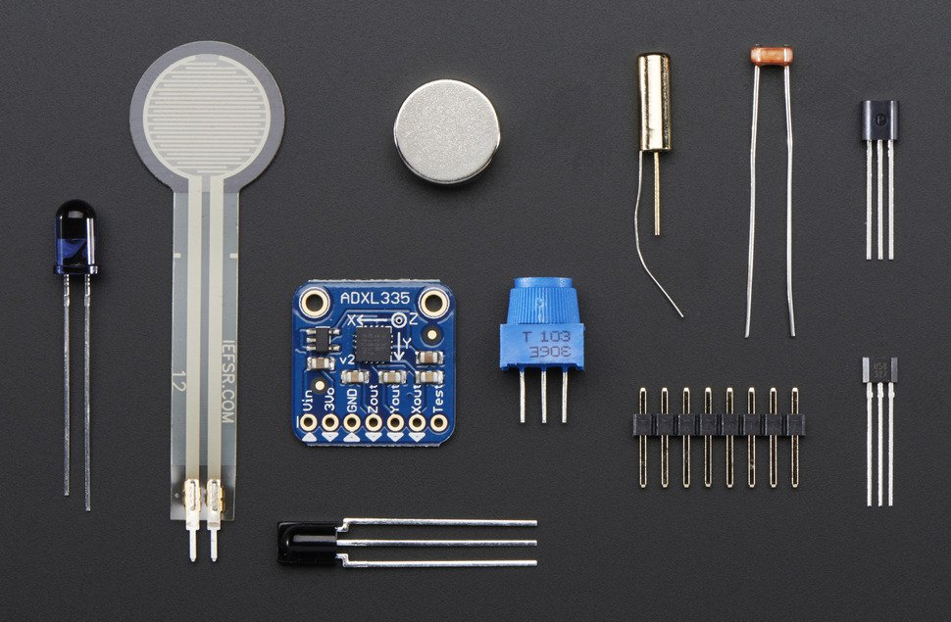
Accessories
Notes:
When it comes to what you can do with a raspberry pi, there are tons of possibilities
Since it has its roots in education, there’s great documentation available for free, and the accessories are cheap
For example, this kit is $35 and includes sensors for temperature, pressure, light, motion, infrared, and magnets
A 3” touch screen is $8
A keypad is $4
Amazon recently made their voice activation and control code freely available – with a $3 mic and a download from their github, you have basically everything you need

Slide 8
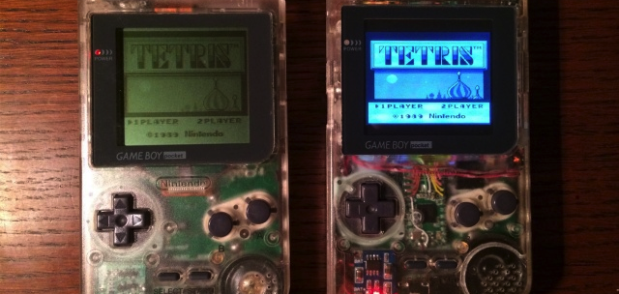
What can you do with one?
http://www.digitaltrends.com/computing/raspberry-pi-projects/
Notes:
Nerdy things

Slide 9
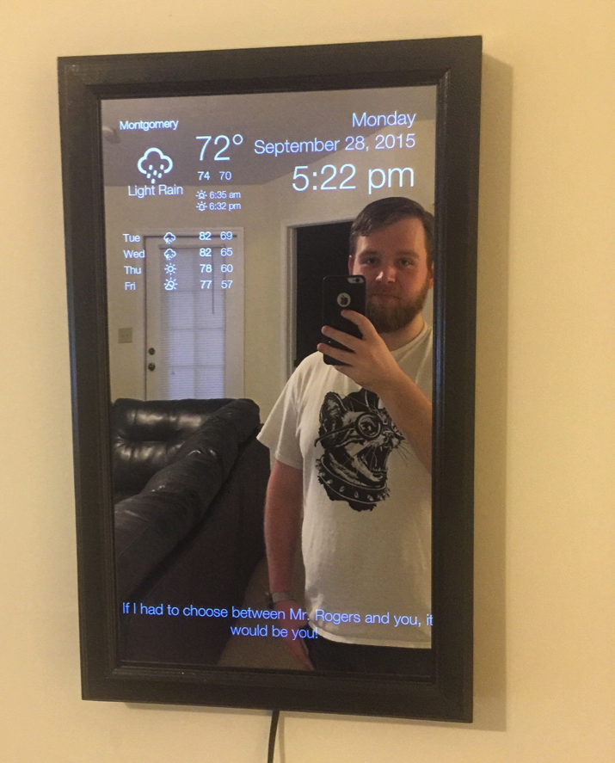
What can you do with one?
Magic Mirror
Redditor LetsSeeSomeKittles (!?)
Built using tutorial from
Michael Teeuw
Notes:
Feel like you live on a spaceship instead of your tiny Boston studio

Slide 10
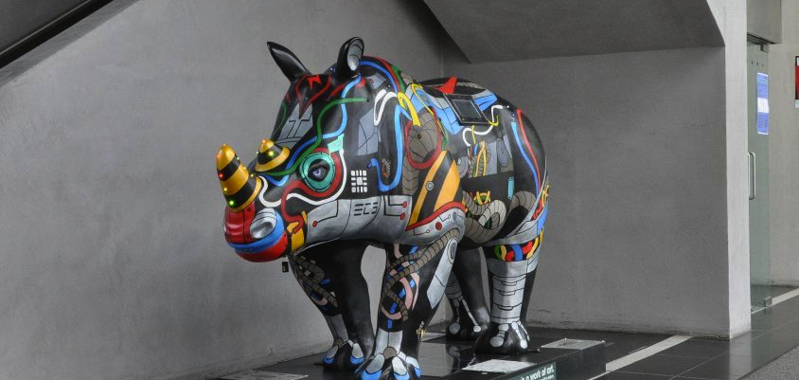
What can you do with one?
University of Southampton’s “Erica the Rhino”
Notes:
You can make art! This rhino has moving ears and eyes that react to visitors

Slide 11
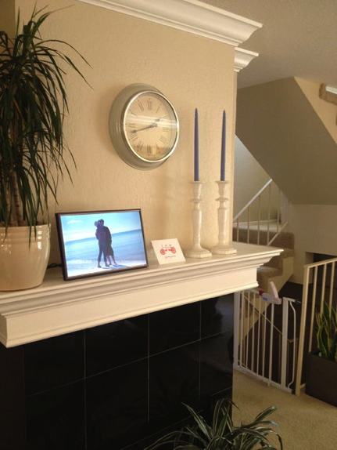
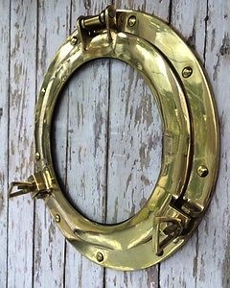
What can you do with one?
http://www.instructables.com/id/How-to-Make-a-Raspberry-Pi-Media-Panel-fka-Digita/
Notes:
You can make your own digital picture frame. Combine that with a screen…
http://www.ebay.com/itm/11-Brass-Porthole-Glass-Window-Nautical-Maritime-Ships-Port-Hole-/251232726136?hash=item3a7ea32c78:g:XXUAAOSwLVZVpCxl

Slide 12
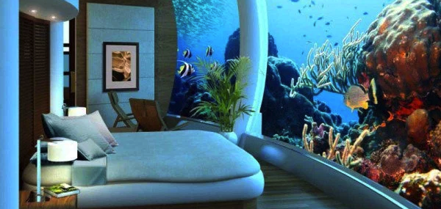
What can you do with one?
Notes:
Poseidon undersea resort, fiji
Why pay $1500 a night when you could have your own underwater experience, with a porthole that plays Blue Planet, or streams every underwater documentary narrated by David Attenborough?
The thing is, there’s a lot of room for creativity.

Slide 13
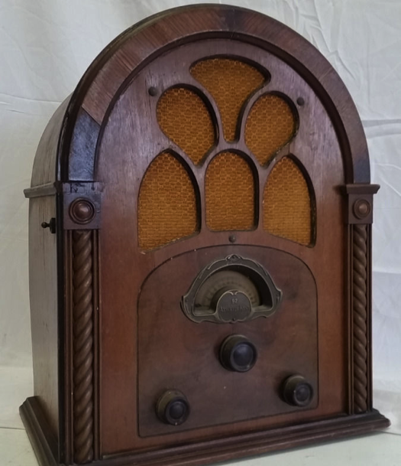
What can you do with one?
My Goal:
Real vintage radio
Working buttons
Plays Pandora stations music from my phone anything
Notes:
So let’s bring this back down to planet earth…
One of the many reasons I love the internet is that almost everything is available. You can learn by doing!
Every project I included has some kind of tutorial, whether an instructable or a youtube video.
Let’s walk through some of the steps together that would be necessary to get started
http://www.instructables.com/id/Raspberry-pi-gone-vintage/?ALLSTEPS
http://www.ebay.com/itm/ANTIQUE-1930s-ATWATER-KENT-TUBE-RADIO-MODEL-92-GOTHIC-DEPRESSION-ERA-CATHEDRAL-/381583199162?hash=item58d8218bba:g:W2oAAOSwI3RW-TlZ

Slide 14
Initial Setup
Format your micro SD card
Download NOOBS to it
Plug in a mouse, screen, and keyboard
Power it on
Select Raspbian to install
Log in with username pi and pw raspberry
Notes:
https://www.raspberrypi.org/help/noobs-setup/

Slide 15
Things to keep in Mind
Follow Linux WDI setup instructions
Make frequent backups
Watch your GB storage limits
Projects need their own power source
Start small
Follow in the footsteps of others

Slide 16
First Project
The initial excitement of ordering a new £25 tiny-puter can quickly turn into procrastination – do I actually have the time or ability to turn this Pi 3 into an automatic cat feeder?
--Andrew Williams for Stuff.TV’
Desktop PC – Done!
Old-School Game Emulator
Make a Media Center
Get a light to blink (says Ethan)
Build a server for your portfolio
Notes:
I looked up some of the best starting projects for a Raspberry Pi.
http://www.stuff.tv/features/3-best-starter-projects-your-raspberry-pi-3

Slide 17
What now??? Adam says…
Get good at something
Set goals
Projects === Practice
Accept failure
Work your ass off
Notes:
So, what would Adam Savage do? When I googled Adam Savage Raspberry Pi, one of the things that came up was a talk that Adam gave at a makers fair, called Ground Rules for Success. And the two that really resonated with me were these:
“Get good at something. Really good. Get good at as many things as you can. Being good at one thing makes it easier to get good at other things.”
Set goals
Projects = practice
Accept failure as part of the process
Work your ass off. It is more important to be a hard worker than it is to be smart. The world is full of geniuses who didn’t do anything, who didn’t achieve anything with their work. The world is packed with idiots who have millions of dollars in the bank because they worked really hard. Work like your life depends on it, because it does.
Before you gave up your life to GA, what kind of projects were you working on? Now that we have this new skill set, what can you imagine?

Slide 18
Resources
Adam Savage, Ground Rules for Success
Adam Savage, Dodos, Maltese Falcons, and the Art of Obsession
Amazon’s Alexa Voice Service
Raspberry Pi’s Educational Foundation GitHub
Quickstart Guide

Slide 19
Contact
Jen Weber, Web Developer
j@jenweber.me
www.jenweber.me
Github.com/jenweber
Linkedin.com/in/jenmweber

